Slide 1


Slide 2
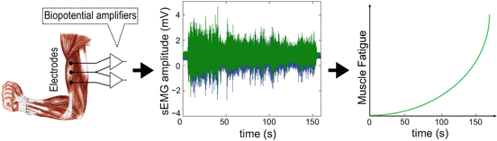
Research Objectives
Develop an EMG-based method to detect muscle fatigue during resistance training and estimate the optimal number of repetitions per set for each individual.
Acquire surface EMG signals during repeated contractions (e.g., biceps curls).
Preprocess and segment EMG to isolate each repetition.
Extract fatigue-related features (RMS, Median Frequency, etc.).
Identify the repetition where performance starts degrading (“optimal repetition”).
Validate the method against subjective exertion or total repetitions to failure.

Slide 3
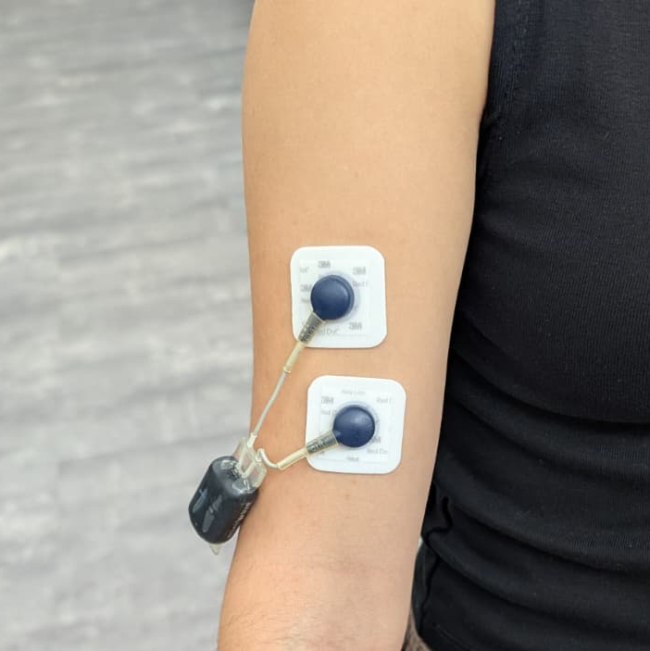
Exercise Protocol
Calibration assessed optimal weight for inexperienced users
Warm-up used a 1kg dumbbell instead of the planned elastic band
Team members ensured subjects maintained proper exercise technique
Surface EMG electrodes were placed on the target muscle after skin cleaning
Subjects performed sets until task failure (loss of good form)
Rest period of 1 minute and 30 seconds was used between sets
Total of 3 to 5 sets were performed to gather sufficient data

Slide 4
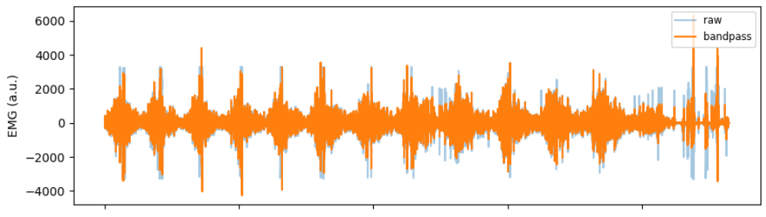
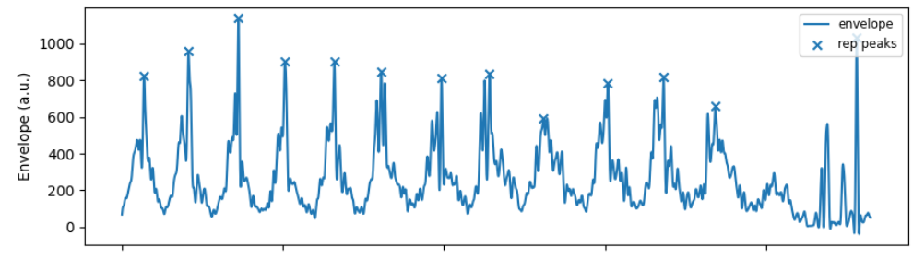
Simple pipeline
Raw EMG → Bandpass Filter (20–450 Hz)→
Notch (50 Hz) → Rectify → Low-pass Envelope→
Rep Segmentation → Feature Extraction (RMS, MDF) →
Fatigue Trend Analysis

Slide 5
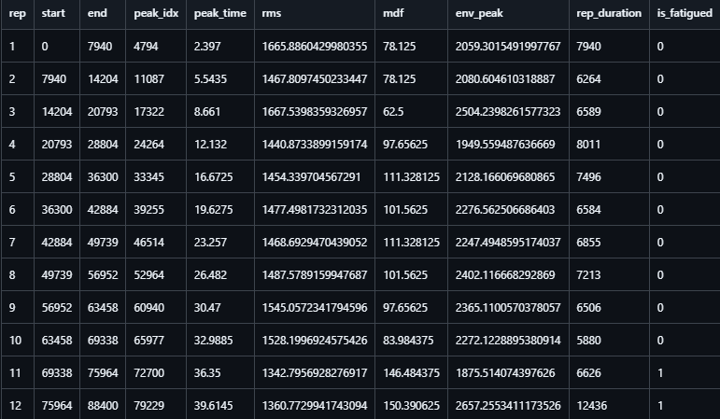
Simple pipeline
Raw EMG → Bandpass Filter (20–450 Hz)→
Notch (50 Hz) → Rectify → Low-pass Envelope→
Rep Segmentation → Feature Extraction (RMS, MDF) →
Fatigue Trend Analysis

Slide 6
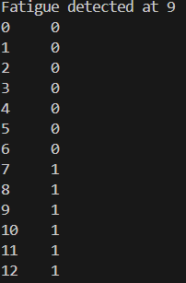
Simple pipeline
Raw EMG → Bandpass Filter (20–450 Hz)→
Notch (50 Hz) → Rectify → Low-pass Envelope→
Rep Segmentation → Feature Extraction (RMS, MDF) →
Fatigue Trend Analysis

Slide 7
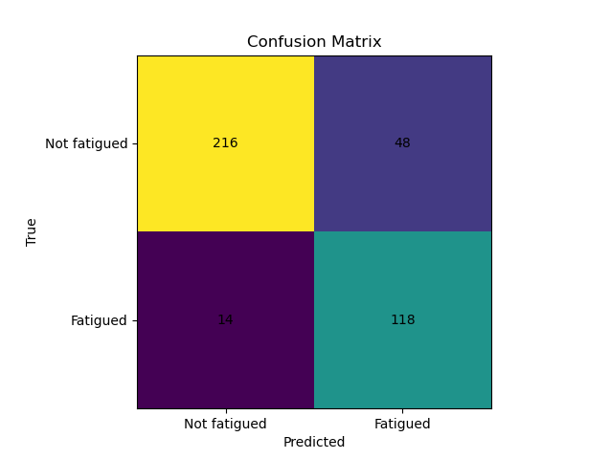
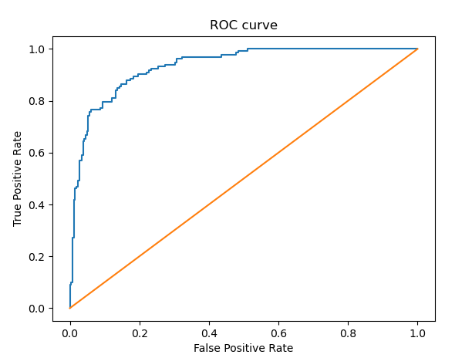
Classification report (OOF):
Not fatigued (0): precision 0.939, recall 0.818, F1 0.874 (support 264)
Fatigued (1): precision 0.711, recall 0.894, F1 0.792 (support 132)
Overall accuracy: 0.843 (396 repetitions)
OOF Balanced Accuracy: 0.856
Late trigger: 42% Early trigger: 30%

